Slide 1
Instructional Design Assessment
- Itisha Sharma

Slide 2
Given the performance gap, write the terminal learning objective and a minimum of two enabling objectives.
4. To improve the implementation of Blue box values
To be able to guide the team member for career development
3. To select the appropriate area of opportunity
2. To identify the various opportunities of career development
1. To explain the Blue box values

Slide 3
Describe what learning modalities you would use to accomplish the learning objectives and why.
The fact that majority of the learners are multimodal, I would prefer developing a repertoire.
To accomplish the learning objectives, I would create the content in the visual and auditory modes as this can be easily, effectively and efficiently processed by our brains. The learners will also be able to recall faster by using these modalities.

Slide 4
Explain what levels within Bloom’s Taxonomy you chose and why.
Objective | Level within Bloom’s Taxonomy | Reasons
To explain the Blue box values | Remember | The learner needs to memorize and tell the Blue box values.
To identify the various opportunities of career development | Understand | The learner needs to recognize and be aware about the various career development opportunities.
To select the appropriate area of opportunity | Analyze | The learner needs to differentiate between opportunities and choose the best out of them.
To improve the implementation of Blue box values | Create | The learner would come up with a creative and effective plan of implementing the Blue box values.

Slide 5
Define your evaluation strategy for the course and how it will be measured.
Stage of evaluation | Objective | Purpose | Measuring Tools
Before the course | - | Assessment to plan the e-learning course effectively and appropriately | Survey method Observations Focus groups
During the course (Formative) | To explain the Blue box values | Evaluate the engagement level of the learners Evaluate the understanding level of the learners | Survey post the micro-learning program Knowledge checks
 | To identify the various opportunities of career development | Evaluate the engagement level of the learners Evaluate the awareness about different career development opportunities | Survey post the micro-learning program Case studies during VILTs
 | To select the appropriate area of opportunity | Evaluate the engagement level of the learners Evaluate the understanding of differentiating and choosing the area of opportunity. | Survey post the micro-learning program Case studies during VILTs
 | To improve the implementation of Blue box values | Evaluate the engagement level of the learners Evaluate the improved plan for implementing the Blue box strategies | Survey post the micro-learning program OJT
After the course (Summative) | To be able to guide the team member for career development | Evaluate the behavioral change in the manager for guiding a team member | Observations

Slide 6
Create a design outline in PowerPoint of an interactive micro-learning covering one enabling learning objective from the assignment.
Design outline must have the following:
– Explanation of the learning management system (which LMS and why)
– Engaging Learner Interactions including how the interaction will work
o Examples: (branching, gamification, ILT) “learner will click on each item and they
will automatically jump to ...”
– Multimedia (or notes about the kind of specific multimedia to be used)
o Examples: photographs, icons, graphs, infographics, videos, etc.
– Content including appropriate formatting and placement
– Navigation (or description of navigation elements)

Slide 7

Explanation of the learning management system (which LMS and why)
Can be integrated with critical business systems like CRM, HRIS, web conferencing etc.
Enables targeted learning
Data is encrypted
Built in reporting and analytics
35+ preconfigured languages
Create dynamic SCORM content within the LMS
Automate a wide variety of tasks like adding new users, group enrolment, and learning path assignments

Slide 8
The micro course on “To explain the Blue box values “.

Slide 9

Visualization notes:
This is the splash page
Display the course name and suitable graphic with background music
Provide a ‘Start the module’ button, clicking which the course will launch.

Slide 10
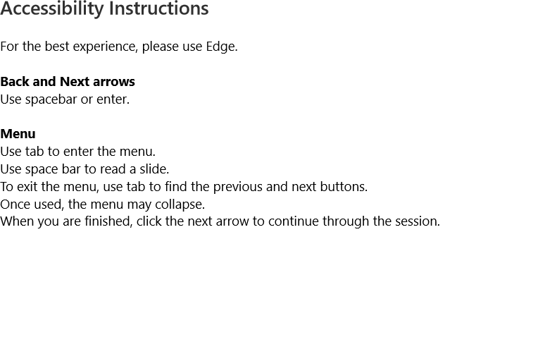
Visualization notes:
This is a splash page to make the learners understand the accessibility
When user clicks on next, this slide transitions to the next slide

Slide 11


Visualization notes:
The characters and text show up in sync with the VO
VO – Meet Linda, our Manager and Nancy a new hire
This slide transitions to the next slide when user clicks Next
Linda, Manager
Nancy, New hire

Slide 12


Visualization notes:
The characters and text show up in sync with the VO
VO – Nancy is confused about what the blue box values means and decided to discuss the concern with her manager Linda.
Image visibility as per the VO– At the start put Nancy’s picture , then the blue box and the question mark and towards the end put Linda’s image.
This slide transitions to the next slide when user clicks Next

Slide 13
Visualization notes:
The characters, callouts and text show up in sync with the VO
VO – 1. Linda could you explain me what blue box values are?
2. Of course Linda. Let me help you with it.
Image visibility as per the VO– At the start put Nancy’s picture along with the callout and then Linda’s image with the callout.
This slide transitions to the next slide when user clicks Next
1. Linda could you explain me what blue box values are?
2. Of course Linda. Let me help you with it.

Slide 14

Visualization notes:
The characters, callouts and text show up in sync with the VO
VO – The blue box values form the core of out organization and help us in excelling in whatever we deliver to our customers.
Image/ callout visibility: After the VO gets complete, the Linda’s image gets smaller and moves to the top left corner of the screen as shown in the next slide.
This slide transitions to the next slide when user clicks Next

Slide 15





Visualization notes:
The characters, callouts and text show up in sync with the VO
VO {Starting from bottom and moving towards the top} –
We do what is right by being reliable and consistent
We respect people and their views
We care about communities because they help us in delivering the best possible product.
And when we offer what the customers want, we win as a team. We excel as one Blue box.
Image/ callout visibility:
Each section of the pyramid including the icons to be displayed in sync with the VO {bottom to top}
This slide transitions to the next slide when user clicks Next
Win as
a team
Care about communities
Respect different views
Respect people
Do what is right

Slide 16
Visualization notes:
The characters, callouts and text show up in sync with the VO
VO – 1. I hope this was helpful.
2. Yes, of course Linda. I appreciate your efforts
Image visibility as per the VO– At the start put Linda’s picture along with the callout and then Nancy’s image with the callout.
This slide transitions to the next slide when user clicks Next
1. I hope this was helpful.
2. Yes, of course Linda. I appreciate your efforts

Slide 17
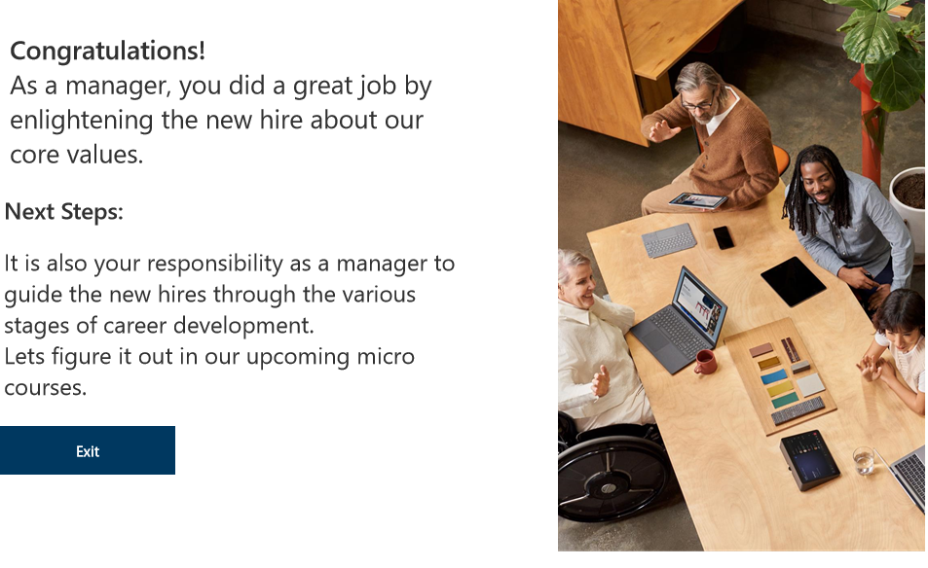
Visualization notes:
This is a splash slide.
2. VO – As a manager, you did a great job by
enlightening the new hire about our core values.
It is also your responsibility as a manager to guide the new hires through the various stages of career development.
Lets figure it out in our upcoming micro courses.
3. Provide a ‘Exit’ button, clicking which the learner will exit the course.

